Slide 1

Travel and Tours-Lb
Rimah Houssameldine

Slide 2
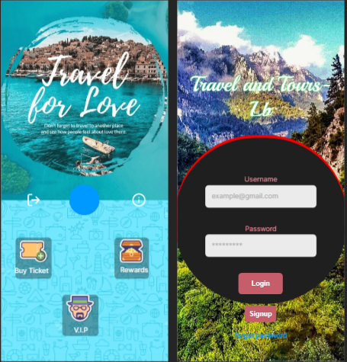
Project overview
The product:
This project is started to help those people who want to travel and discover Lebanon and don't know which place to visit this app will provide all the information required.
Project duration:
May 2022 – June 2022

Slide 3
Project overview
The problem:
The problem is that, when foreign visitors come to our country to visit Lebanon they don't know much about it that's why they face different problems.
The goal:
Travel and Tours-Lb
is an app which works on IOS, Android and on web which will provide all the details about the best places to visit.

Slide 4
Project overview
My role:
UI Designer, UX Researcher, Prototyping, etc.
Responsibilities:
-Low fidelity prototype
-High fidelity prototype
-User flow
-Journey map
-Design the interface of the application

Slide 5
User research
Personas
Problem statements
User journey maps
User flow
Understanding
the user

Slide 6
User research: summary
Researches, focuses on audience’s and user’s needs, observations, ideas and motivations.
In this project, we tend to distribute qualitative surveys
by the help of Google forms.

Slide 7
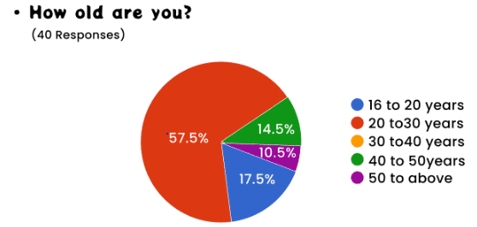
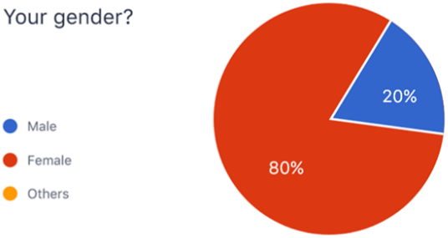
User research: summary

Slide 8
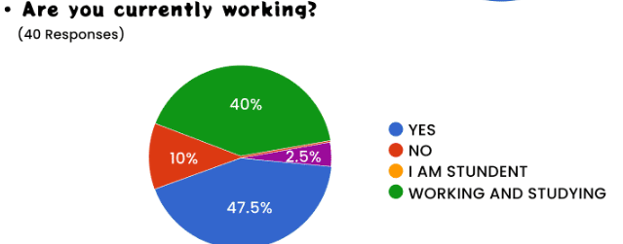
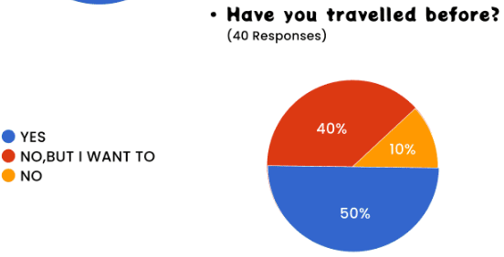
User research: summary

Slide 9
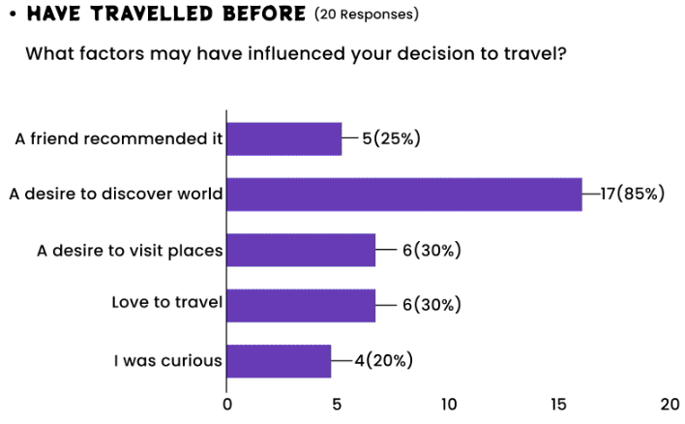
User research: summary

Slide 10
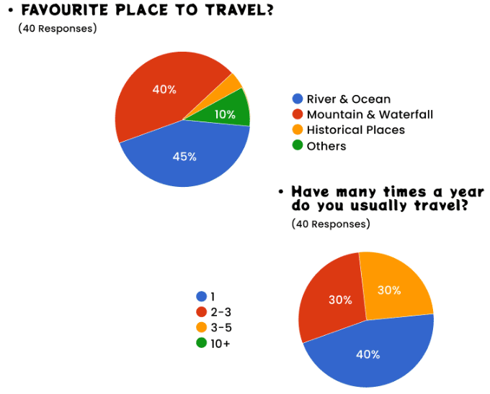
User research: summary

Slide 11
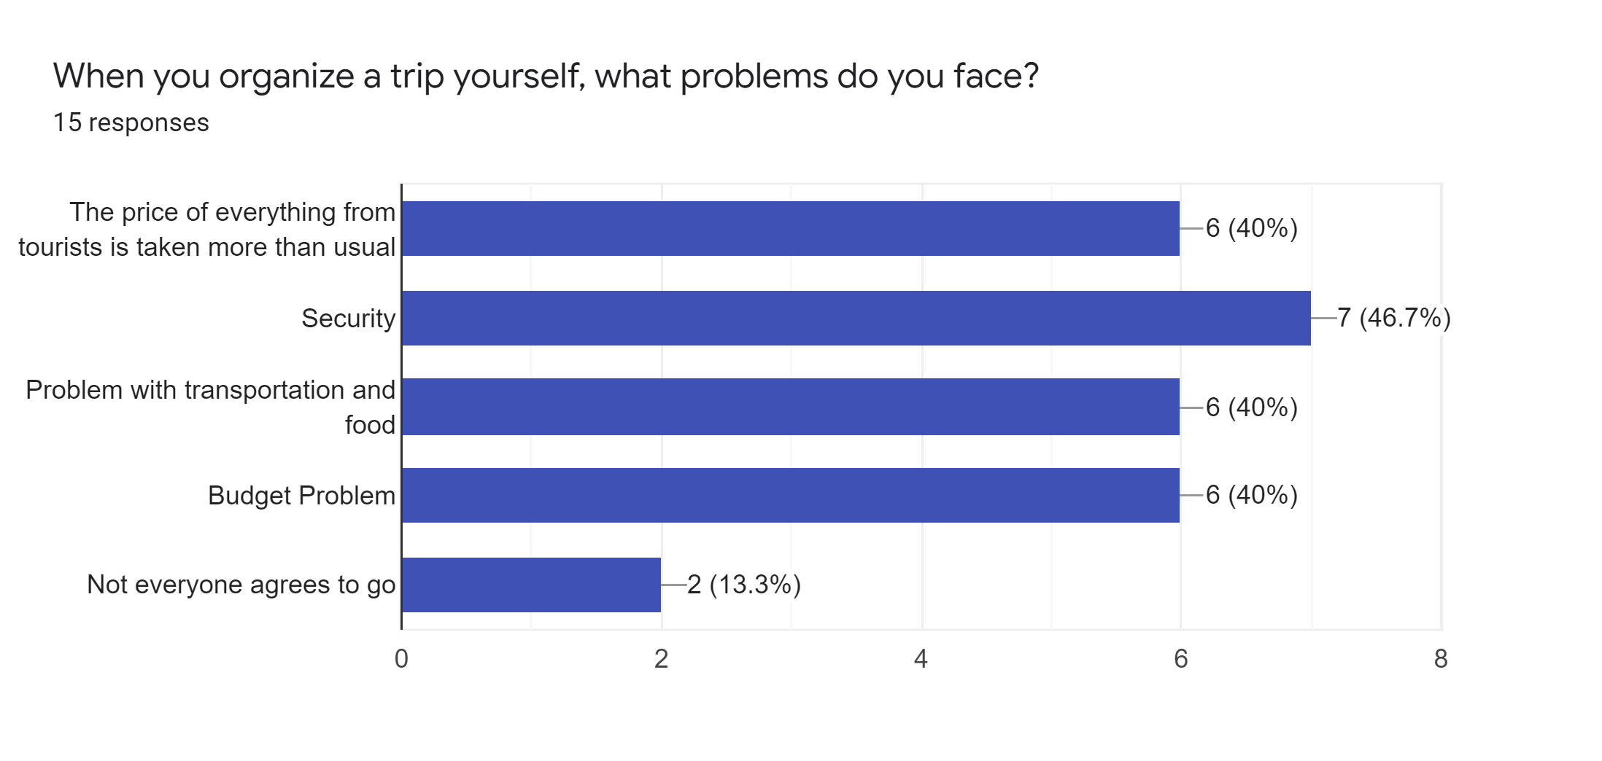
User research: summary

Slide 12
User research: pain points
1
2
3
Pain point
Pain point
Pain point
Since the app is free and would run ads only for finance us, we might face an issue keeping the app free.
The app provides rate feature to rate the places in Lebanon. Therefore group of people might create rating attacks on to lower the rate for one beyond another.
The app would suggest some places for the users to visit, we fear that the algorithm doesn’t work well and suggest un-liked place for the user and the user delete the app

Slide 13
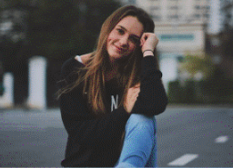

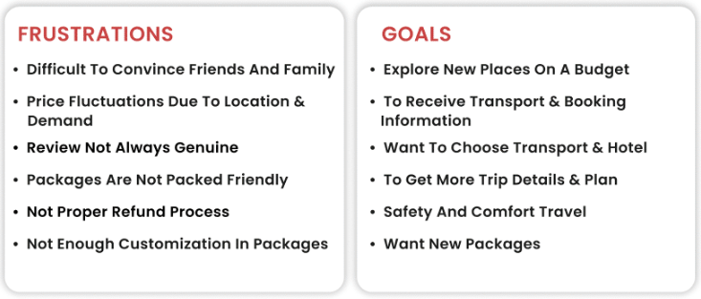
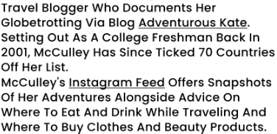
Persona: Grace
Problem statement:
Grace is a travel blogger. Who loves to travel across Lebanon discovering new places and experience the local culture, who needs to get as much local information about places in Lebanon.
Grace McCulley
Age: 28
Education: Solo Traveler
Hometown: New York

Slide 14
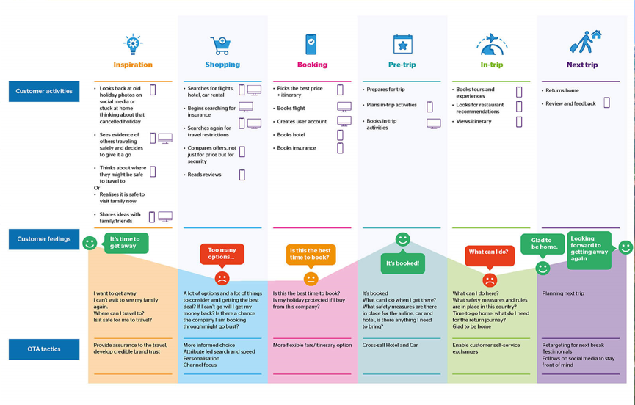
User journey map:

Slide 15
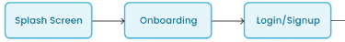
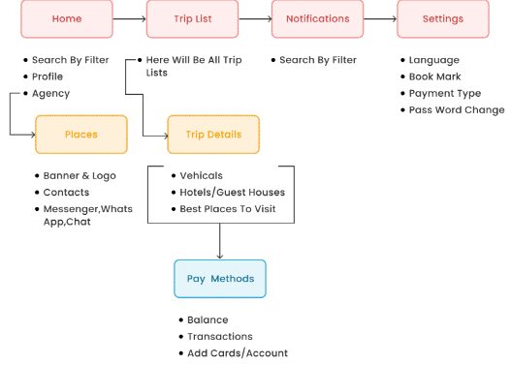
User flow:

Slide 16
Paper wireframes
Digital wireframes
Low-fidelity prototype
Usability studies
Starting
the design

Slide 17
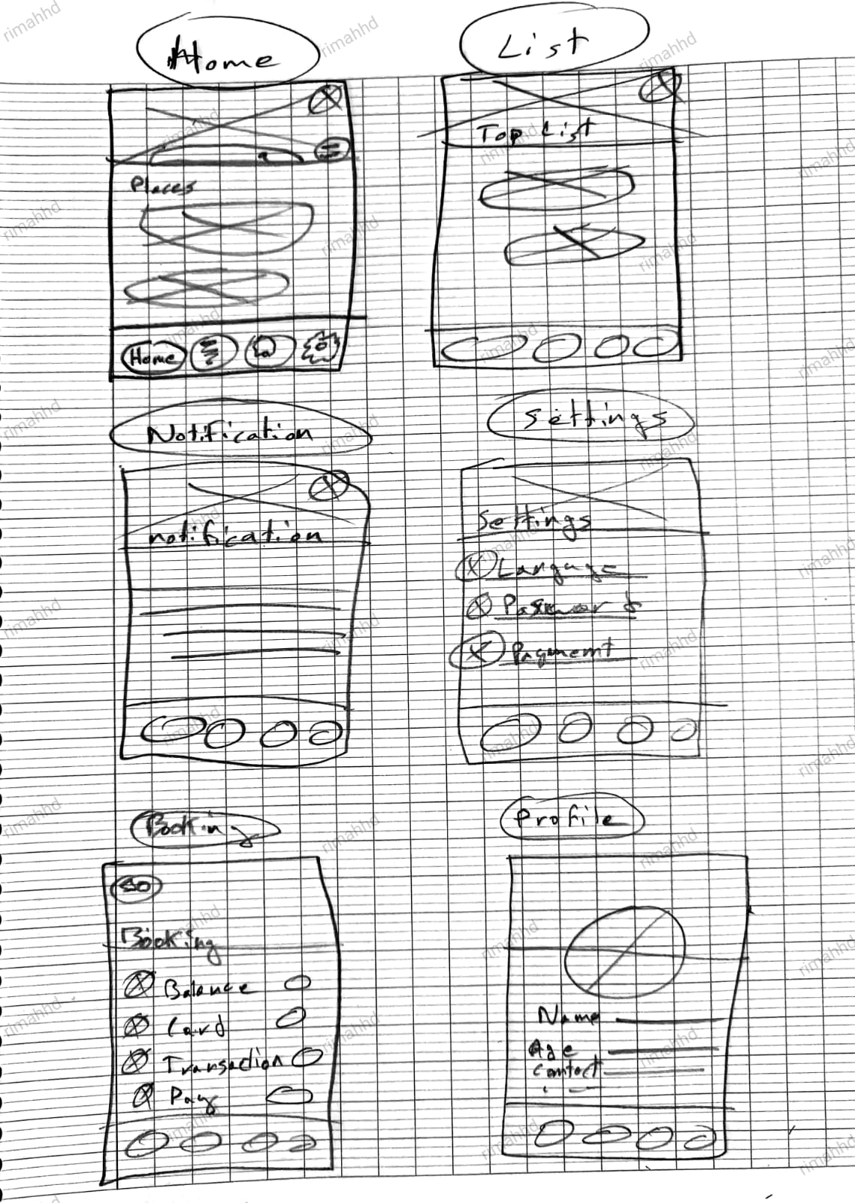
Paper wireframes
We started our design phase by using the simple paper wire framing technique to be the base prototype of the app

Slide 18
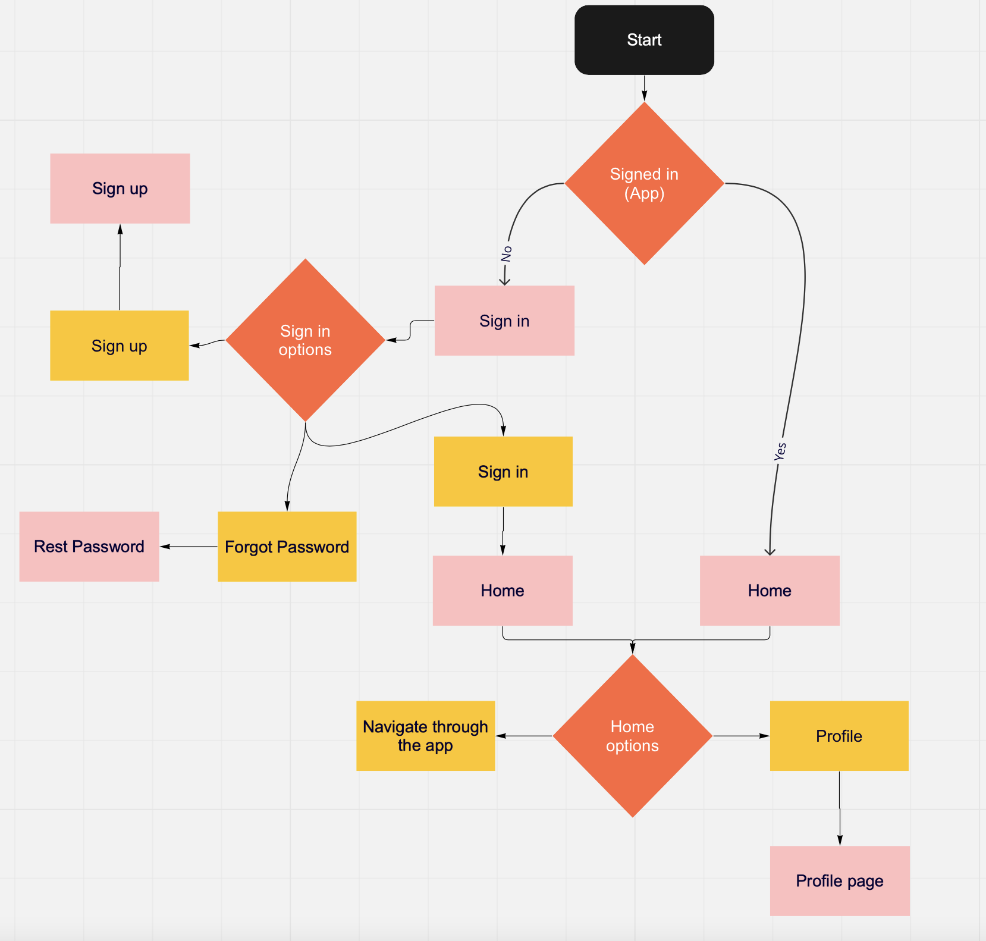
Digital wireframes
Then we used digital wireframing to present the functionality of the app

Slide 19
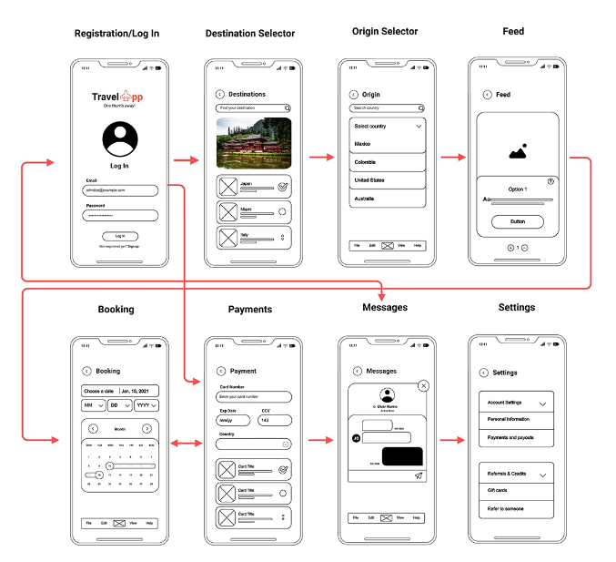
Digital wireframes
After that we used the low fidelity prototype as the app prototype

Slide 20
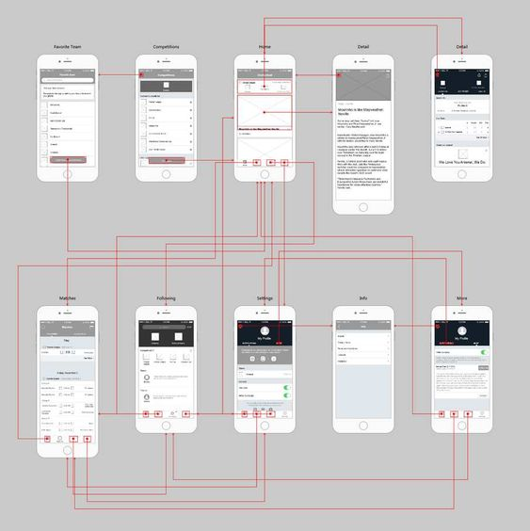
Low-fidelity prototype
With this Low Fidelity prototype, we can see how the user can navigate between pages, beginning with the Log In page and progressing to the main page where he/she can explore the offers by selecting the destination and also filtering by hotel rate, location, and price range, narrowing down to choose the number of rooms and guests, and then applying all to get the deal he/she likes and then proceeding to payment by selecting to reserve their best offer. In addition to seeing his favorites and searches, the user may view details about his profile by selecting Profile from the home page.

Slide 21
Usability study: findings
Few researches and app testing was involved in the development process to come up with few founding :
Round 1 findings
Round 2 findings
1
Colors with more contrast are preferred in the background
1
Simple, meaningful icons are better to use for user experience
2
The app design should all be linked together
2
Use more images and illustrations
3
Interface should always be simple
3
The interface should not be boring

Slide 22
Refining
the design
Mockups
High-fidelity prototype
Accessibility

Slide 23
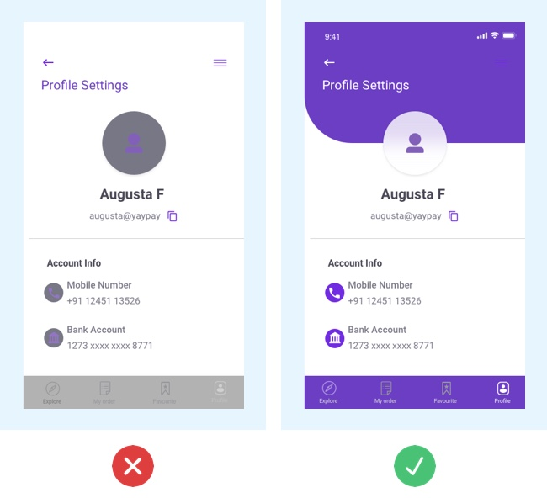
Mockups
Before usability study
After usability study
The colors of the app were really annoying for users to look at, and the ui elements were really annoying because of the small size and appearance of the buttons

Slide 24
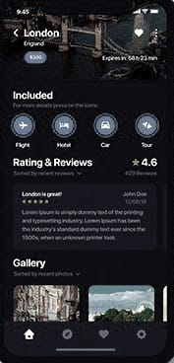
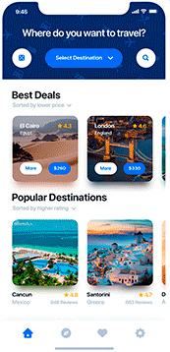
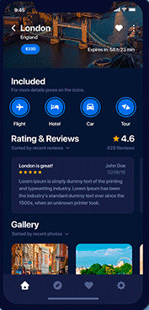
Mockups
Before usability study
After usability study
Light theme
Dark theme
Studies have shown that people with normal or corrected vision have a better performance, however, people with stronger visual disorders will tolerate Dark mode better. But Light mode has a cost associated to the better performance, and it is the long-term risk of eye disease.

Slide 25
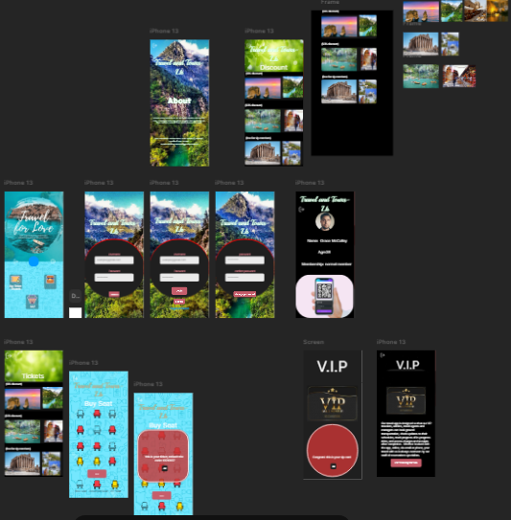
High-fidelity prototype
Click Me
https://framer.com/projects/Untitled--swAUOUEpV06RIy7eEUbL

Slide 26
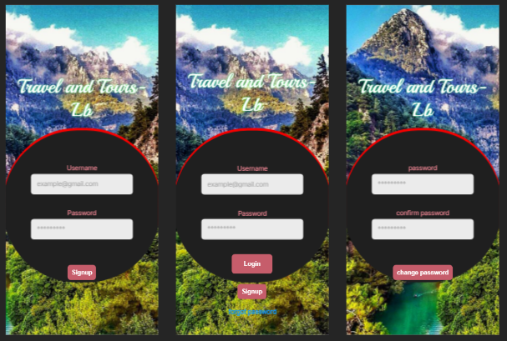
High-fidelity prototype

Slide 27
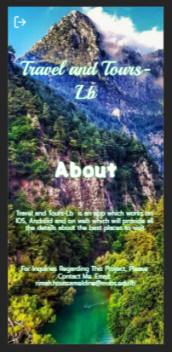
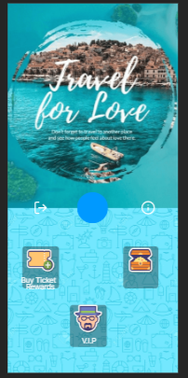
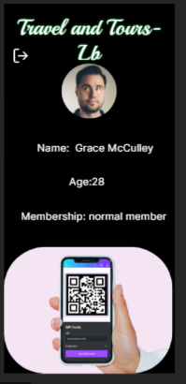
High-fidelity prototype

Slide 28
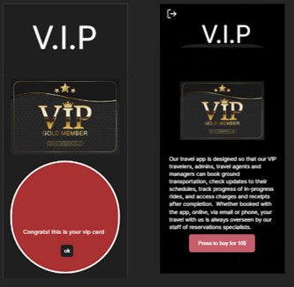
High-fidelity prototype

Slide 29
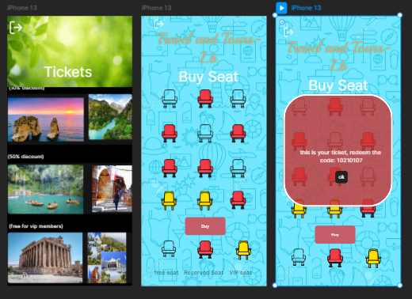
High-fidelity prototype

Slide 30
Accessibility considerations
1
2
3
Adding colors that make more contrast in the ui elements and the background
Using color blind friendly colors that does not hurt or affect color blinds (in the future)
Increased button and font size in the ui elements to be a friendly app for people suffering from vision problems

Slide 31
Going forward
Takeaways
Next steps

Slide 32
Takeaways
Impact:
The app has a great design and animations in addition the features that will help people find what they really like and enjoy their travel.
What I learned:
Through the journey of designing this application, I've learned how to create great design interfaces using framer and how to develop the journey map, user flow, wireframes, know fidelity prototypes

Slide 33
Next steps
1
2
3
Publish the app in a beta version for family and friends to get reviews before publishing to public
Developing the design into a real application and import database before releasing it as an official app in the future
Improving the user experience and design of the app to make it easier to use for all age groups

Slide 34
Let’s connect!
For Inquiries Regarding This Project, Please Contact Me.
Email: rimah.houssameldine@mubs.edu.lb

